Slide 1
PROXY Pattern
The whole idea of a proxy pattern is to have a local module that will mimic the functionality of the real module. This way the application will deal with this local module as if it only contains the real functionality. All the logic for communicating to the remote module can be put inside this local module i.e. Proxy.
proxy pattern Provides a surrogate or placeholder for another object to control access to it

Slide 2
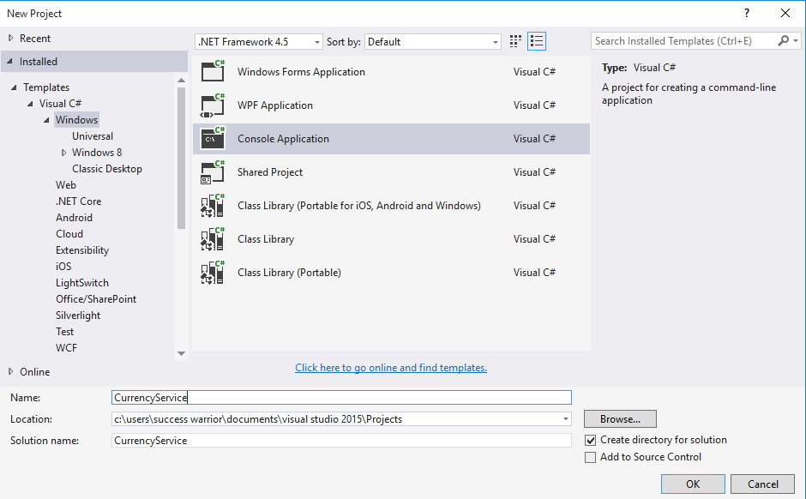

Slide 3
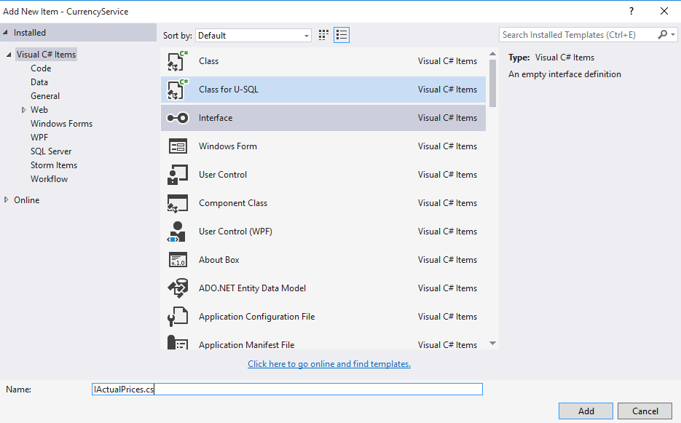

Slide 4
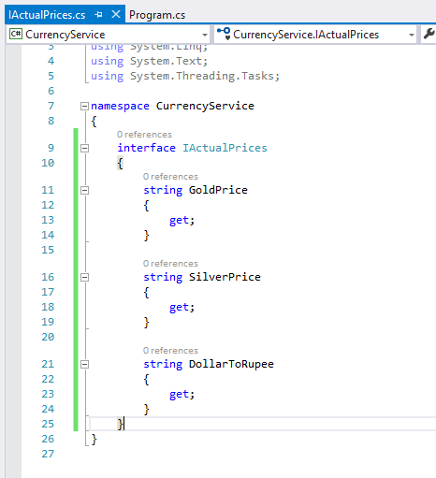

Slide 5
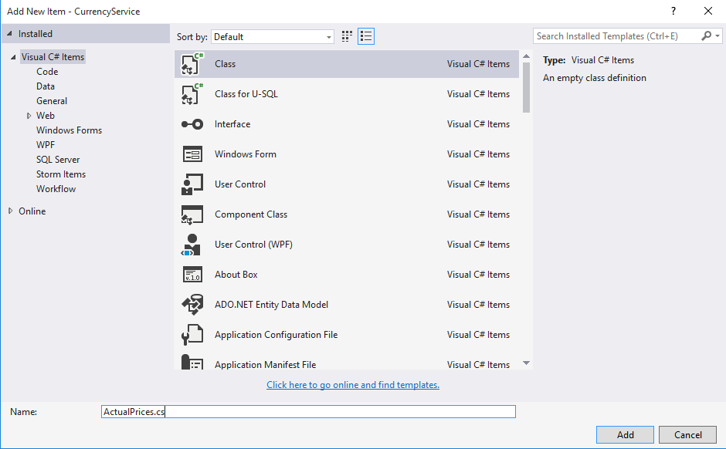

Slide 6
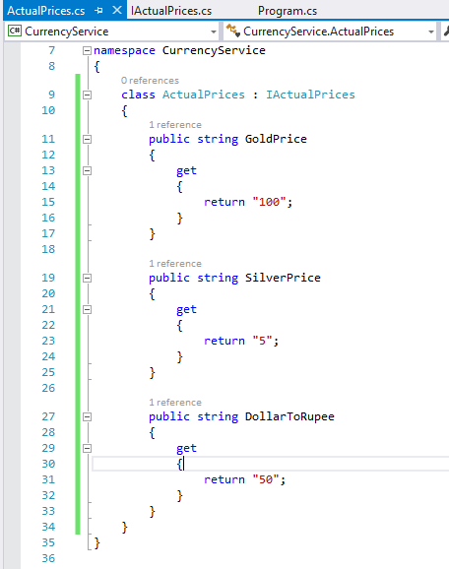

Slide 7
Now if we want that this server application can
Communicate with client application then first we need to provide that logic in main method

Slide 8
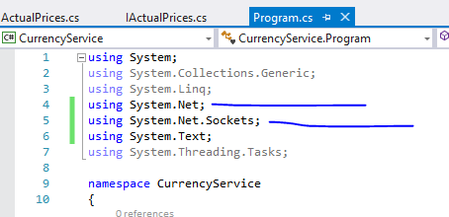

Slide 9
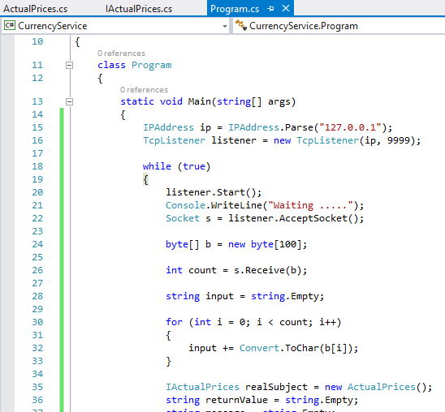

Slide 10
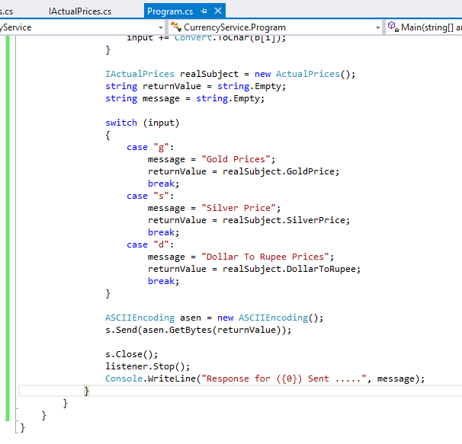

Slide 11
Now let’s create client

Slide 12
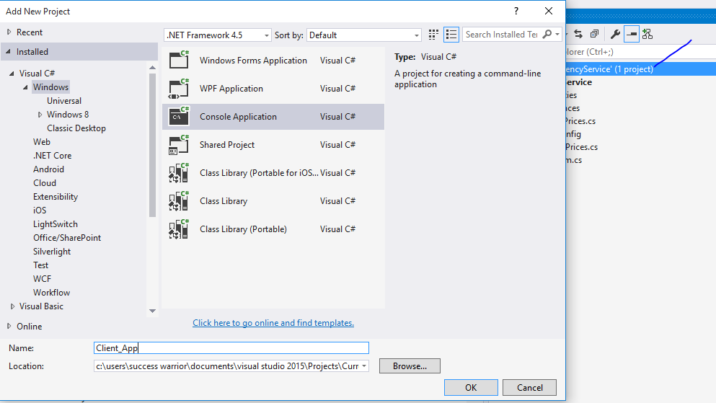

Slide 13
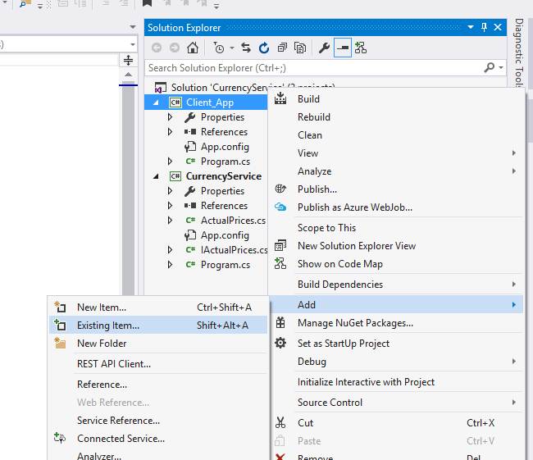

Slide 14
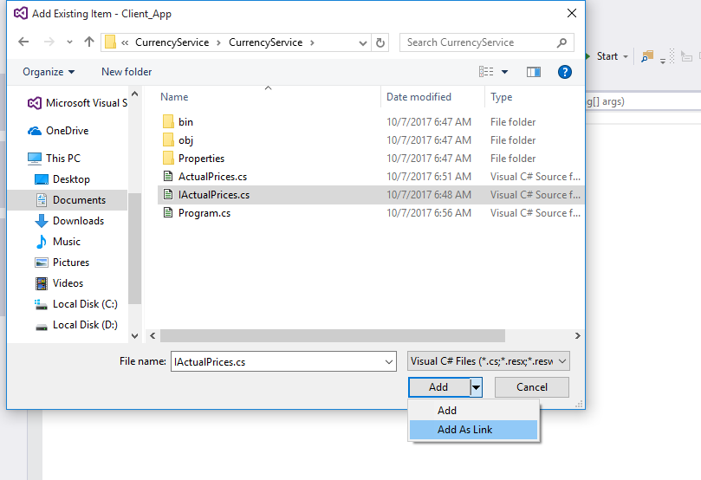


Slide 15
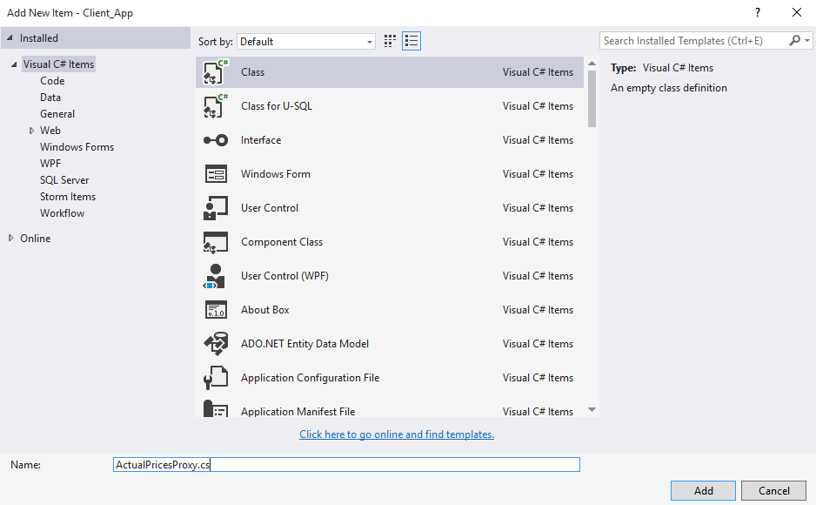

Slide 16
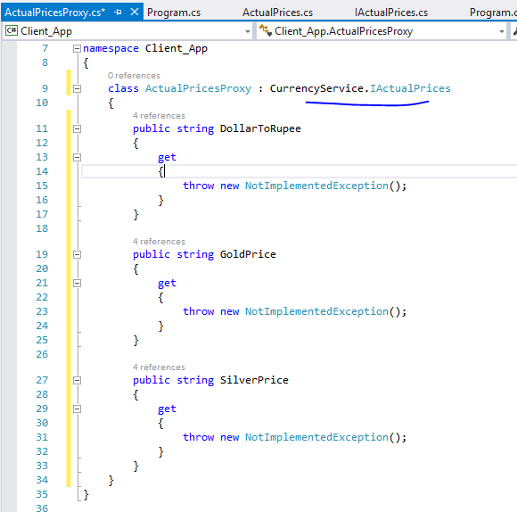

Slide 17
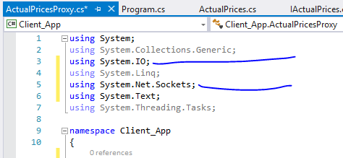

Slide 18
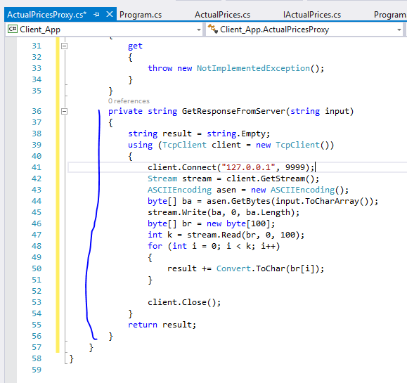

Slide 19
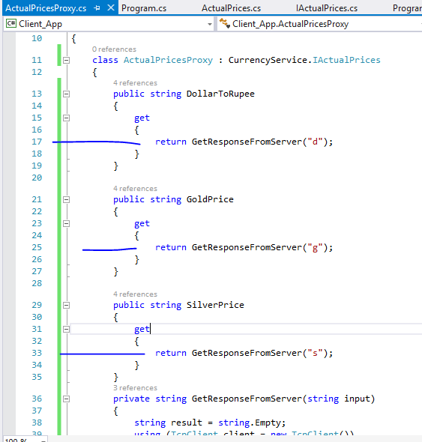

Slide 20
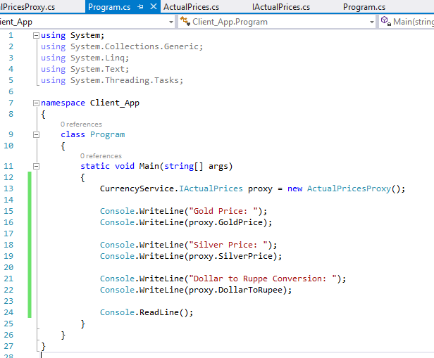

Slide 21
